Slide 1
Economic Efficiency
Notes:
1

Slide 2
Consumer surplus
Consumer surplus is equal to the difference between the buyer’s willingness to pay and the actual price paid
Consumer surplus measures the net benefits from consumption
If consumer surplus increases, then consumers are better off
Notes:
Better off

Slide 3
How is consumer surplus measured?
Consumer surplus is the area below the demand curve and above the market price.
P
6
D
5
Q

Slide 4
Producer surplus
Producer’s surplus is the difference between the lowest price a firm would have been willing to accept and the price it actually receives.

Slide 5
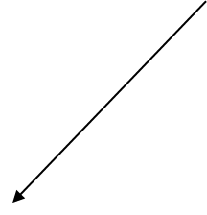
How is producer surplus measured?
P
S
Producer surplus is measured by the area below the price and above the supply curve.
6
5
Q

Slide 6
1. What does economic analysis suggest regarding the impact on economic efficiency of government imposed price ceilings & price floors?

Slide 7
Economic well-being and total surplus
Total Surplus
Consumer Surplus
+
Producer Surplus
=
When this surplus is MAXIMISED the level of economic well-being is also maximised
Notes:
maximised

Slide 8
Economic Surplus/ Total Surplus = Consumer surplus + producer surplus
Price
c.s.
Supply
Equilibrium
price
p.s.
Demand
0
Equilibrium
quantity
Quantity

Slide 9
Market Efficiency
The economic well-being of a society is measured as the sum of consumer surplus and producer surplus - total (economic) surplus.
Market efficiency is attained when the allocation of resources maximises total surplus.
Notes:
Maximises

Slide 10
Sources of Market Inefficiency
Deadweight Loss
The decrease in total (economic) surplus that results from a market not being in competitive equilibrium
Notes:
51

Slide 11
Price Ceilings & Price Floors
Price Ceiling
A legally established maximum price at which a good can be sold. ( e.g. rent ceilings, ceilings on petrol prices)
Price Floor
A legally established minimum price at which a good can be sold. (e.g. agricultural prices, minimum wage laws)
The results of Govt intervention: Price ceilings or Price floors
Some people win; winners
Some people lose; losers
There is a loss of economic efficiency; economic inefficiency
Notes:
4
4
Maximum, minimum

Slide 12
Surpluses before the Rent Ceiling (C.S.= a+b+c and p.s. = d+e+f)
S_{A}
a
900
b
c
700
Rent (dollars per unit per month)
e
d
Rent
Ceiling
500
f
D
0 20 30 40
Quantity (thousands of units per month)

Slide 13
A Rent Ceiling – change in consumer surplus
S_{A}
a
900
b
c
700
Rent (dollars per unit per month)
e
d
Rent
Ceiling
500
f
D
0 20 30 40
Quantity (thousands of units per month)

Slide 14
A Rent Ceiling – change in producer surplus
S_{A}
a
900
b
c
700
Rent (dollars per unit per month)
e
d
Rent
Ceiling
500
f
D
0 20 30 40
Quantity (thousands of units per month)

Slide 15
A Rent Ceiling – deadweight loss = c+e
S_{A}
a
900
b
c
700
Rent (dollars per unit per month)
e
d
Rent
Ceiling
500
f
D
0 20 30 40
Quantity (thousands of units per month)

Slide 16
Price Floors
A price floor is a regulation that makes it illegal to sell at a price lower than a specified level.
It is the minimum price that should be paid for a commodity.

Slide 17
Wool Price Floor – effect on producer surplus
Price per kg
S
A
Surplus
$12
Minimum price
B
C
$8
E
D
D
Qty (millions kgs

Slide 18
Wool Price Floor – effect on consumer surplus
Price per kg
S
A
Surplus
$12
Minimum price
B
C
$8
E
D
D
Qty (millions kgs

Slide 19
Wool Price Floor Deadweight loss
Price per kg
S
A
Surplus
$12
Minimum price
B
C
Total surplus has decreased
$8
E
D
D
Qty (millions kgs

Slide 20
Problem
P Qd Qs
10 120 20
15 110 60
20 100 100
25 90 140
30 80 180
35 70 220
The revenue collected at equilibrium.
After the imposition of the price floor at $30 per crate what will be the revenue if govt does not buy surpluses
What would be farmers revenue if the government purchases the surplus? How much govt has to spend?

Slide 21
8A) The equilibrium quantity is 100 million crates of oranges per year and the price is $20 per crate. The revenue collected at equilibrium is shown by the area of the rectangle represented by the solid (orange) vertical lines. The total revenue will be 20 x 100 000 000 = $2000 000 000, i.e. $2 billion.
8B) After the imposition of the price floor at $30 per crate, 80 million crates of oranges will be demanded whereas 180 million crates will be supplied, creating a very large surplus of 100 million crates. If the government does not purchase the surplus oranges then the revenue received by the producers is equal to the area of the rectangle represented by the dotted horizontal lines. The revenue will be $30 x 80 000 000 = $2400 000 000, or $2.4 billion.
8C) If the government purchases the surplus then the farmers will essentially receive the higher floor price of $30 for all of the 180 million crates supplied, so their revenue will be much higher at $30 x 180 000 000 = $5400 000 000, or $5.4 billion. The government will spend $3 billion ($3000 000 000) to purchase the surplus of 100 million crates. This is shown by the area of the rectangle represented by the dotted angled lines.

Slide 22
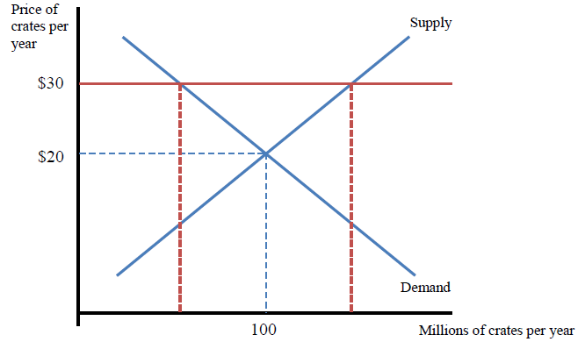

Slide 23
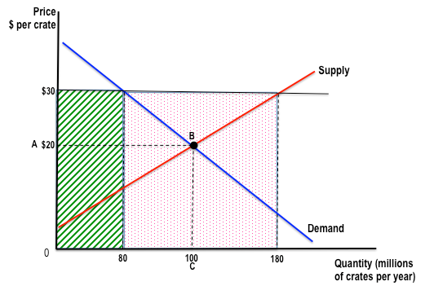

Slide 24
Suppose the competitive equilibrium rent for a standard two-bedroom apartment in Adelaide is $1000 per month. Now suppose the state government passes a rent control law imposing a price ceiling of $800 per month.
- Use a demand and supply graph to illustrate the impact of the rent control law.
- Suppose that shortly after the law is passed a large employer in the area announces that it will close a factory in Adelaide and lay off 1000 workers. Show on your graph how this might affect the market for rental property in Adelaide.

Slide 25
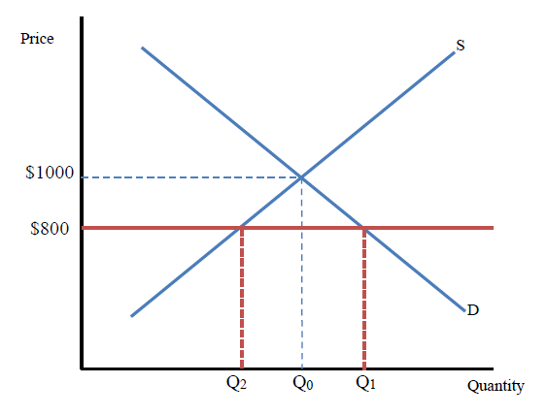

Slide 26
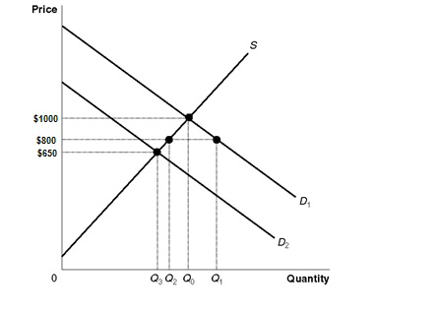

Slide 27
The rent control law will push the price down from $1000 to $800, creating a shortage equal to Q1 – Q2, since only Q2 apartments will be supplied at $800.
The layoffs of workers will shift the demand curve leftward from D1 to D2, which will cause the shortage to shrink.
If the demand curve shifts in far enough, the rent ceiling law will become irrelevant and there will be no shortage
because the new equilibrium price will be below $800 as shown in Figure 3.13. Q3 will be the new equilibrium quantity.

Slide 28
Suppose that initially the petrol market is in equilibrium at a price of $2.00 per litre and a quantity of 45 million litres per month. Then a war in the Middle East disrupts production of oil, shifting the supply curve for petrol from S1 to S2. The price of petrol begins to rise and consumers protest. The government responds by setting a price ceiling of $2.00 per litre. Use the graph to answer the following questions.

Slide 29
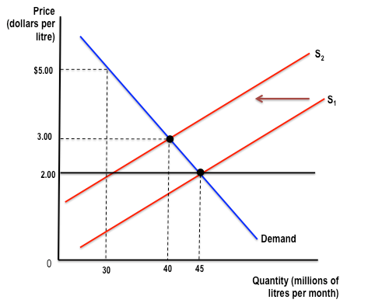

Slide 31
d. Assuming there is no black market, some consumers are made better off by the price ceiling as they can purchase petrol at a lower price than they otherwise could. However, some consumers will not be able to find petrol at a price of $2.00 and will be worse off. Consumer surplus without the price ceiling is A + B + E, but with the price ceiling, it would be A + B + C. (C is larger than E even though it does not appear so in the graph because of scale adjustments. The area of E is ½ × 10 000 000 × $2.00 = $10 000 000, while the area of C is $1.00 × 30 000 000 = $30 000 000.)

Slide 32
7. The government wants to decrease the consumption of alcohol by teenagers by imposing a large tax on ‘alcopops’.
a. Should this tax be placed on buyers or sellers? Explain.
b. Who would pay more of the tax – buyers or sellers? Include a diagram in your answer.
c. In what way could this tax be considered ‘efficient’?
d. Is it better to tax goods that are elastic or inelastic?

Slide 33
Should the tax be imposed on buyers or sellers?
Taxes can be levied on buyers or sellers
It doesn’t matter who the tax is levied on, shifting the D or S curve by the same amount has the same effect and are equivalent
A tax on sellers will decrease supply
A tax on buyers will decrease demand
Notes:
31
21

Slide 34
A Tax on Sellers
5.00
4.00
3.00
2.50 2.00
1.00
0
S + tax on sellers
S
A tax on sellers shifts the S curve upward by the amount of the tax
Price (dollars per bottle)
D
50 75 100 125 150 175 200 225
Quantity (millions of bottles per year)

Slide 35
A Tax on Buyers
5.00
4.00
3.00
2.50
2.00
1.50
1.00
0
S
A tax on buyers
shifts the D
curve downward
by the size of
the tax
Price (dollars per bottle)
D
D - tax on buyers
50 75 100 125 150 175 200 225
Quantity (millions of bottles per year)

Slide 36
Taxes
Equivalence of tax on buyers and sellers
A tax on buyers has the same effect as a tax on sellers
In both cases the equilibrium quantity decreases by the same amount and equilibrium P rises by the same amount

Slide 37
Who pays more of the tax – the buyer or the seller?
It depends . . . on the elasticity of demand and supply
Notes:
39
29

Slide 38
A Tax on Sellers – Inelastic D: tax burden more on buyers
5.00
4.00
3.00
2.00
1.00
0
S + tax on sellers
S
The tax burden on the buyer is one dollar
The tax burden on the seller is 50 cents
Demand curve is relatively less elastic as compared to supply curve so more burden on buyers
2.50
Price (dollars per bottle)
D
50 75 100 125 150 175 200 225
Quantity (millions of bottles per year)

Slide 39
A Tax on Sellers – Elastic D: more burden on sellers
5.00
4.00
3.00
2.00
1.00
0
S + tax on sellers
S
The tax burden on the buyer is 50 cents
The tax burden on the seller is $1
D curve is relatively more elastic than supply curve.
3.50
Price (dollars per bottle)
D
50 75 100 125 150 175 200 225
Quantity (millions of bottles per year)

Slide 40
The Incidence of Tax
Who pays more of the tax – the buyer or the seller?
Buyer pays more if demand is less elastic as compared to supply
Seller pays more if demand is more elastic as compared to supply
Notes:
39
29

Slide 41
c. In what way could this tax be considered ‘efficient’?
What about the efficiency of a tax?
How does a tax affect consumer & producer surplus?
Will total surplus increase or decrease?

Slide 42
Taxes and Efficiency
After a tax, consumers will pay more and consume less
Consumer surplus will decrease
A Tax on Sellers – Inelastic D: loss in consumer surplus
After a tax, producers will receive less and sell less
Producer surplus will decrease
Notes:
decrease

Slide 43
Taxes and Efficiency
The tax results in a deadweight loss – a decrease in total surplus
It is inefficient due to the DWL.
But the tax raises revenue which is re-spent in the economy

Slide 44
d. Is it better to tax goods that are elastic or inelastic?
What goods should we tax?
Objective should be to
MAXIMISE TAX REVENUE and
Decrease the DEADWEIGHT LOSS
Therefore tax goods that are relatively inelastic

Slide 45
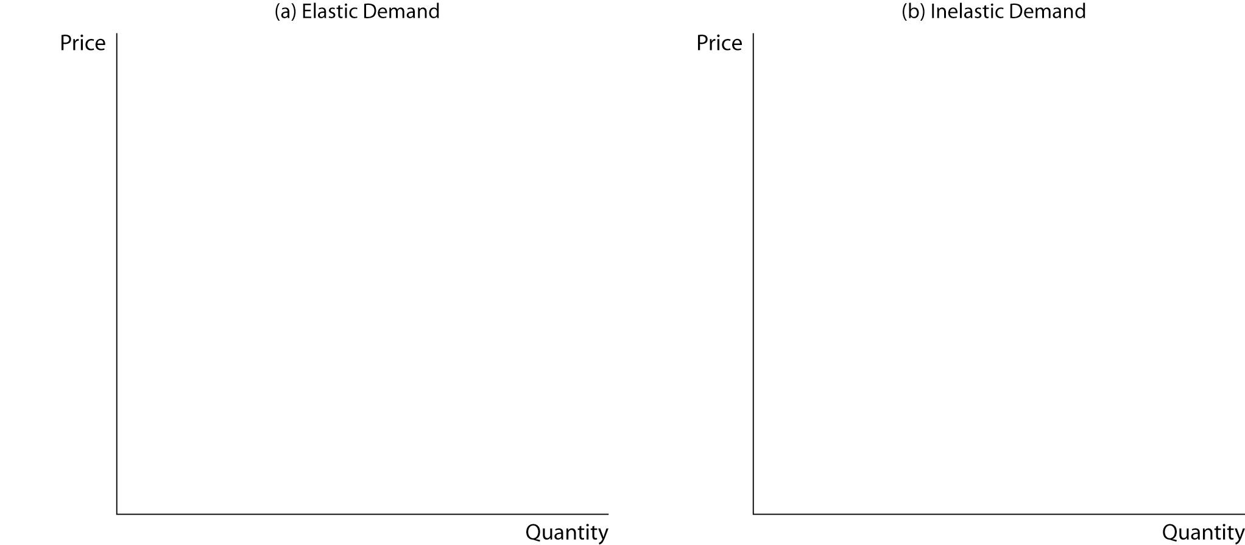
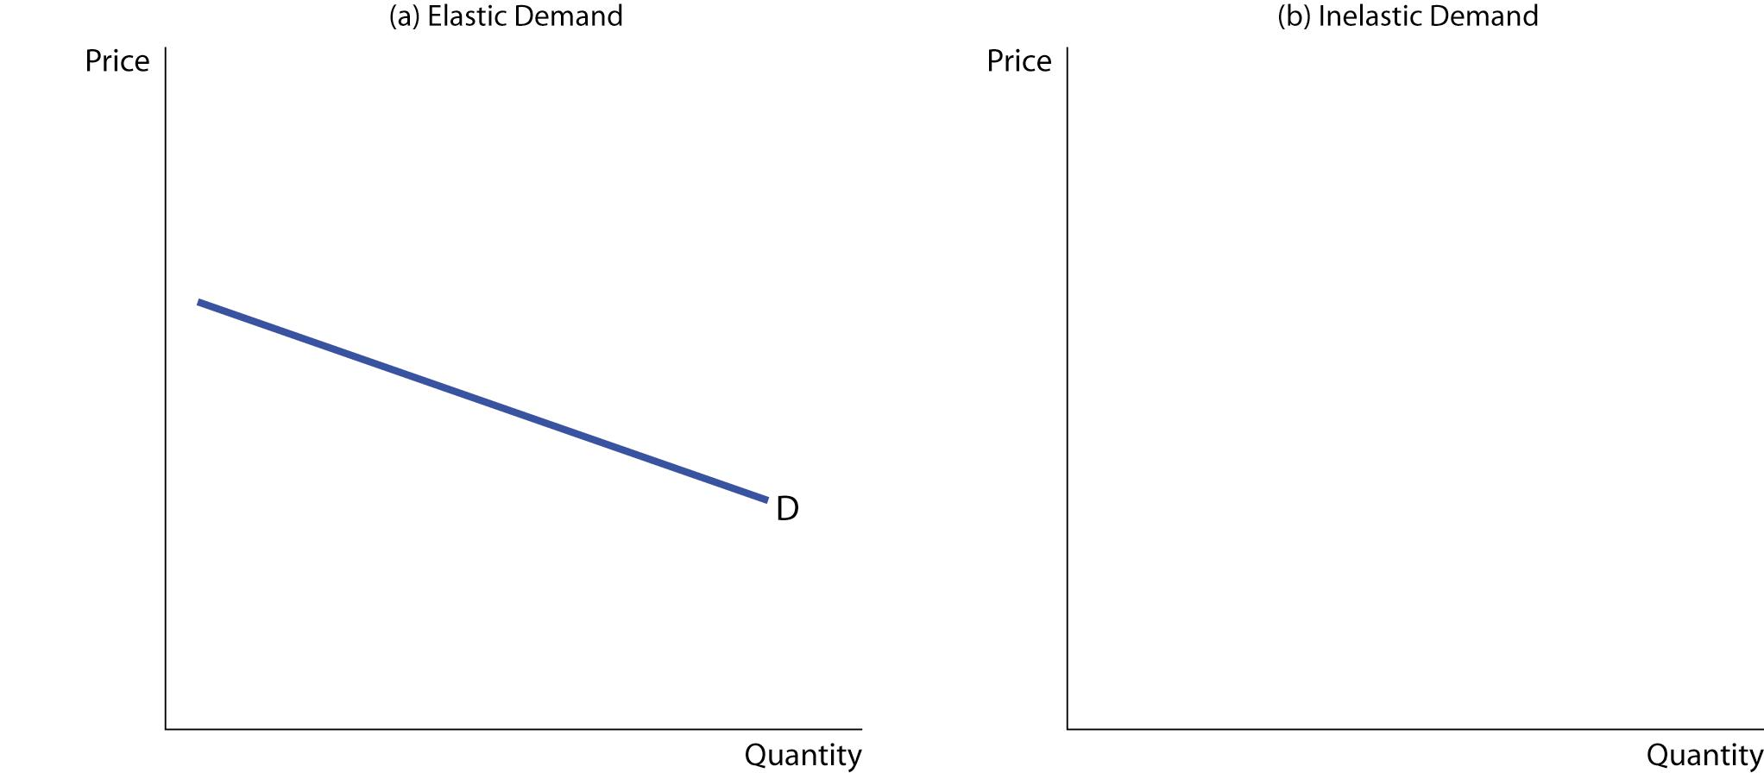
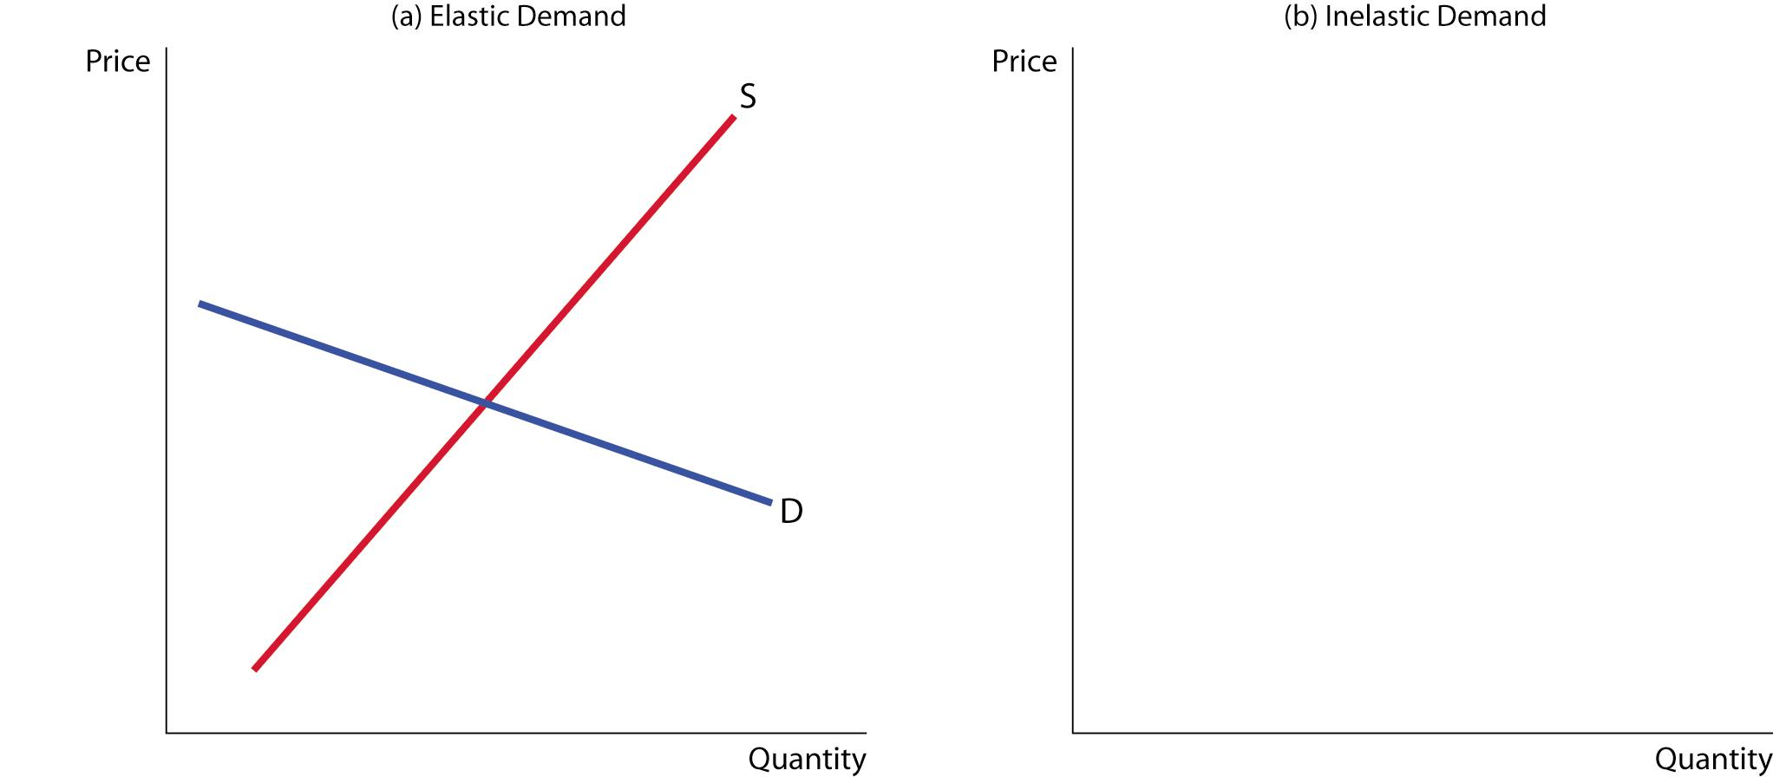

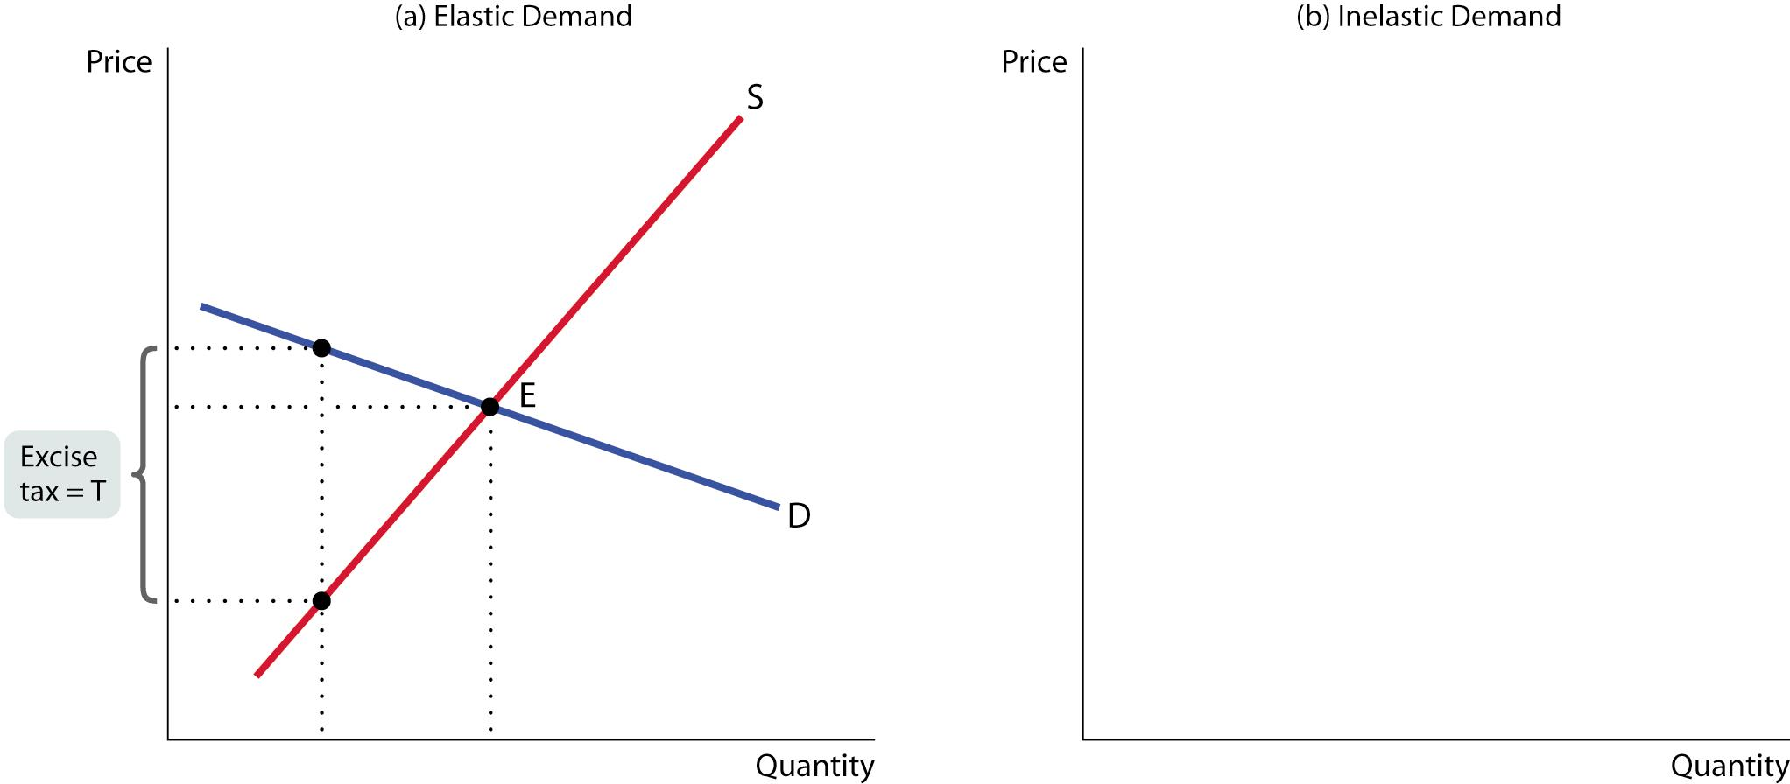
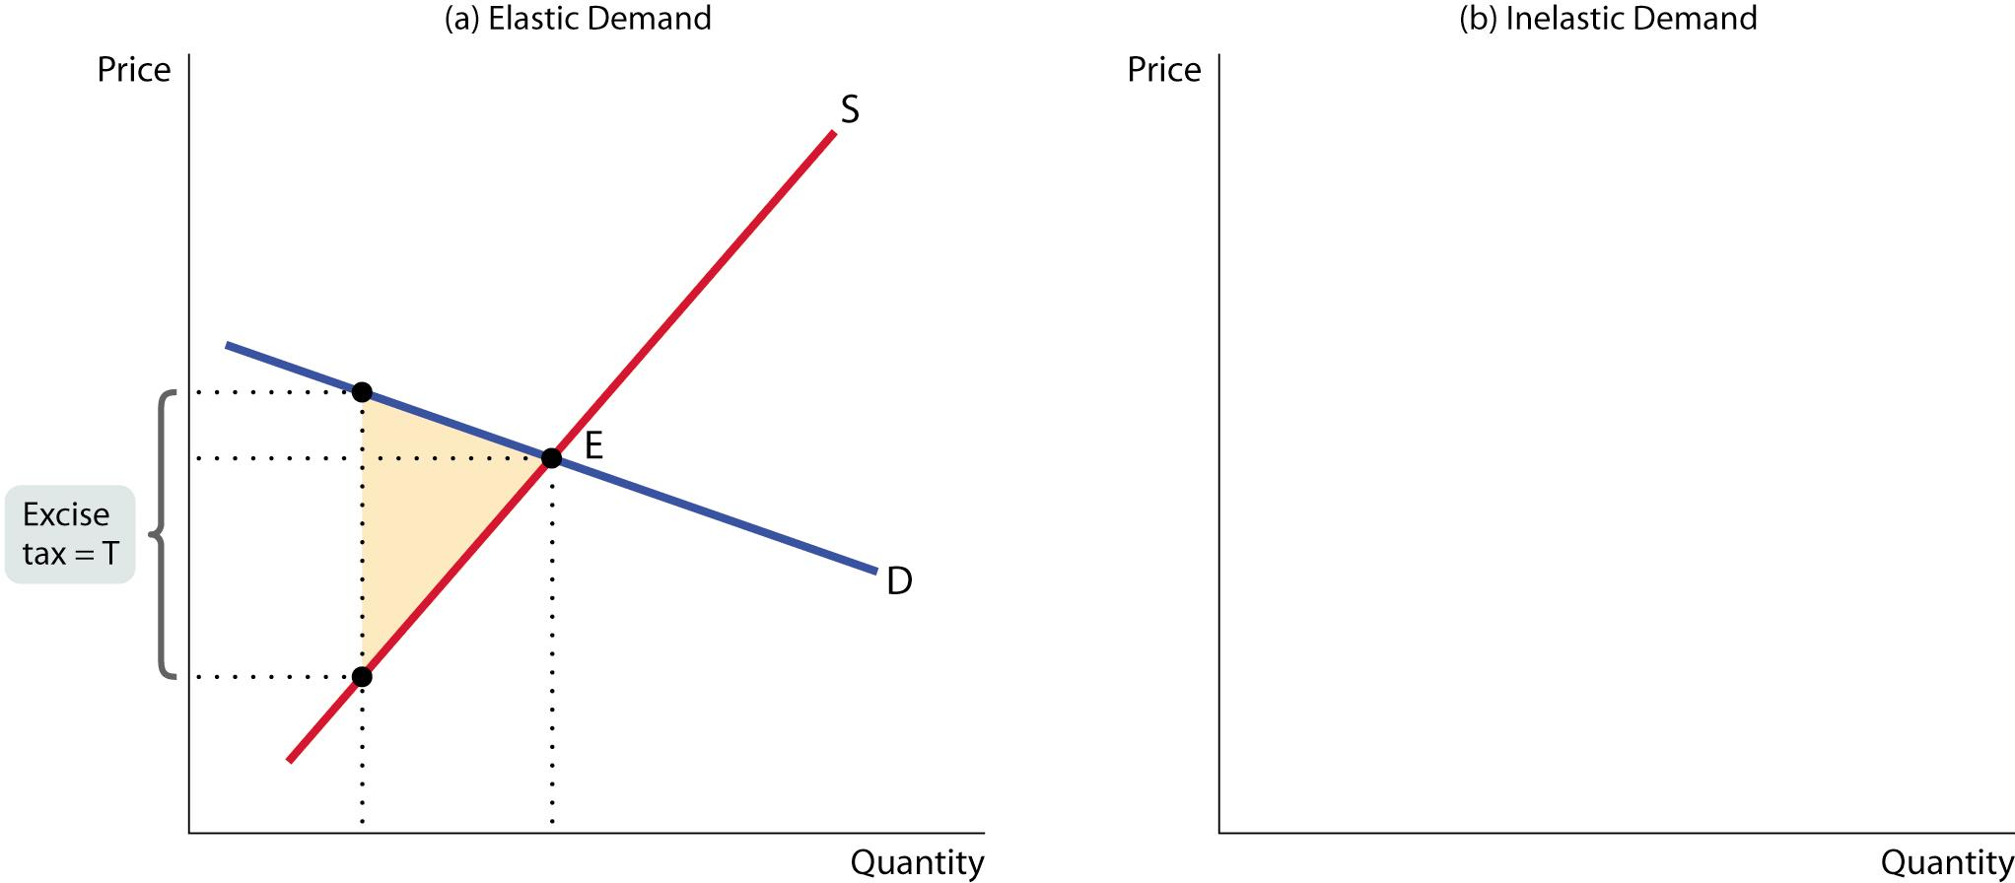
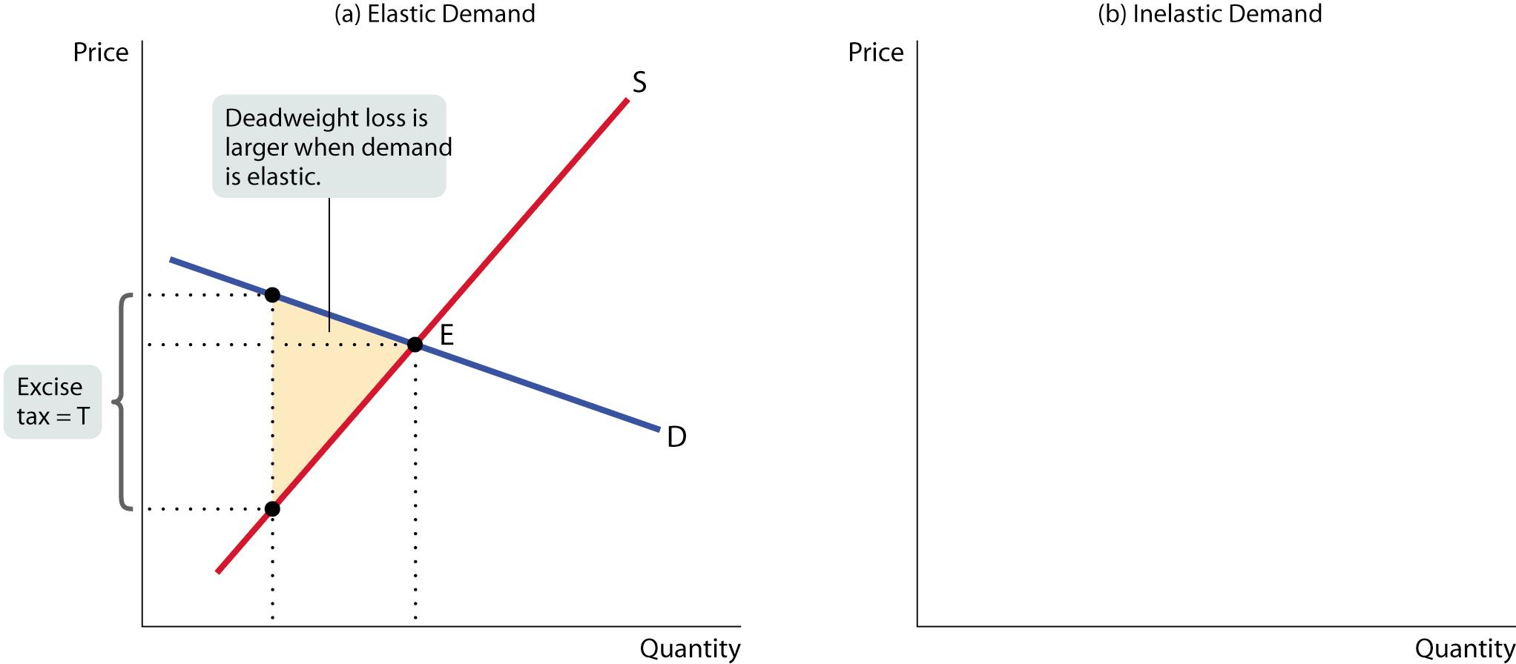
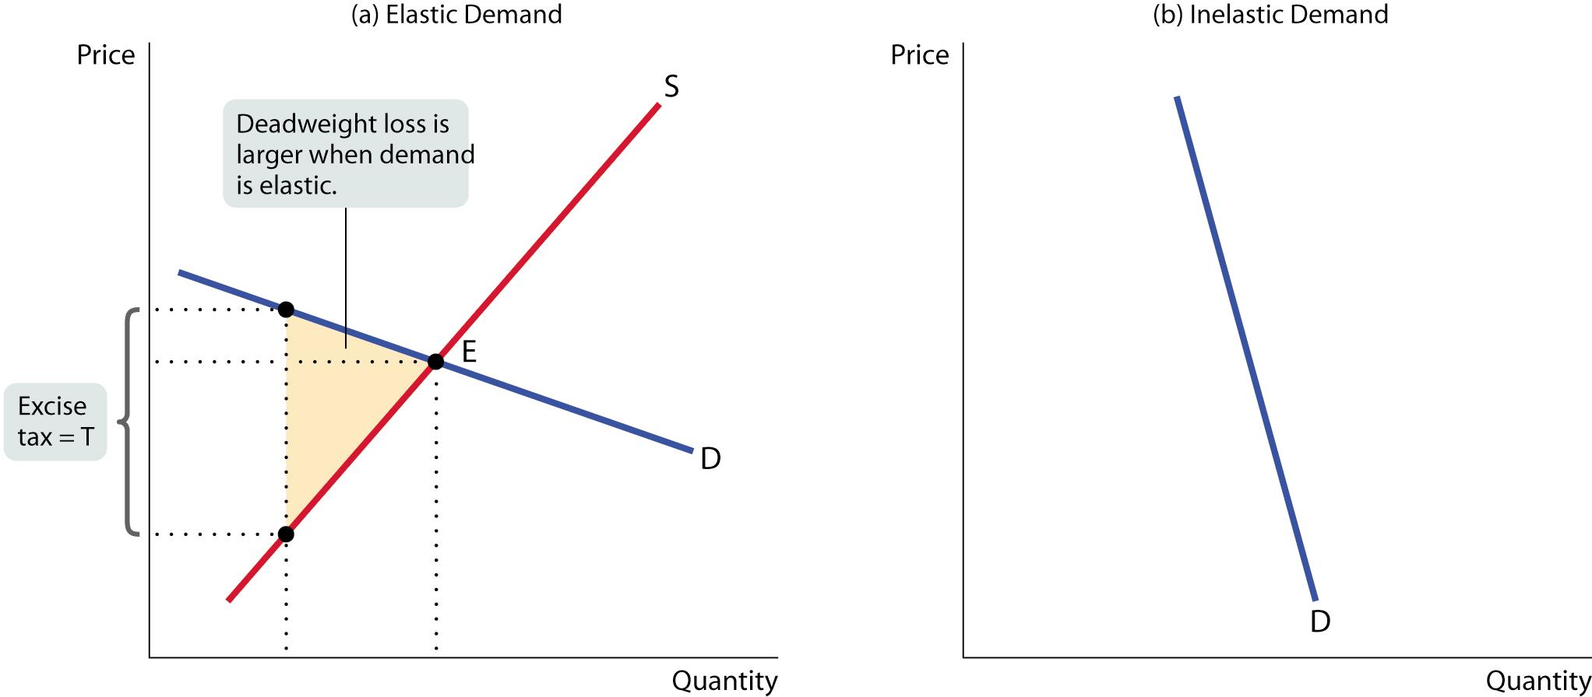
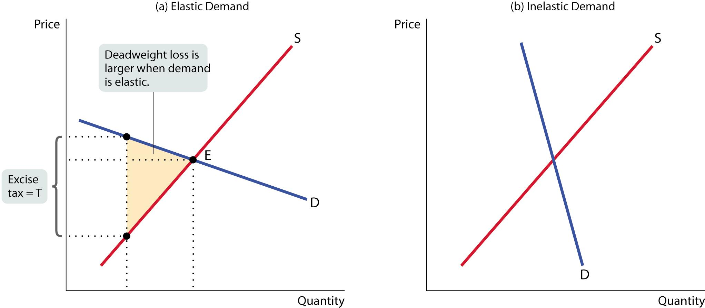
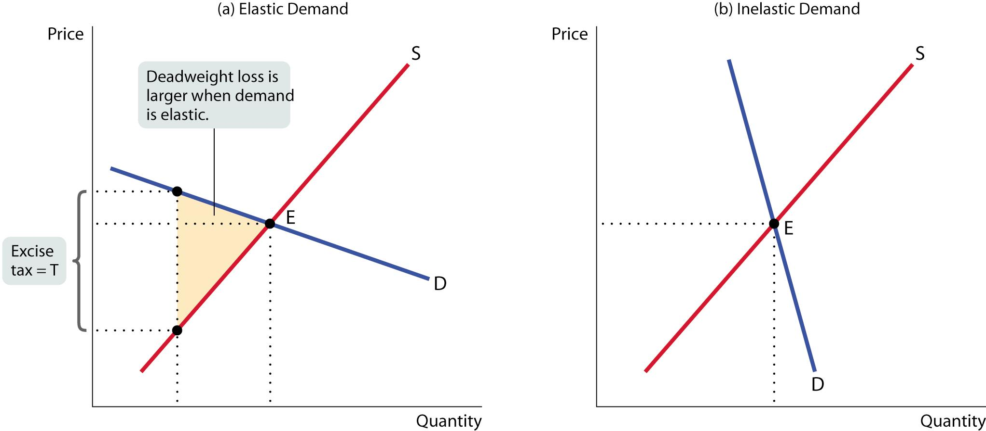
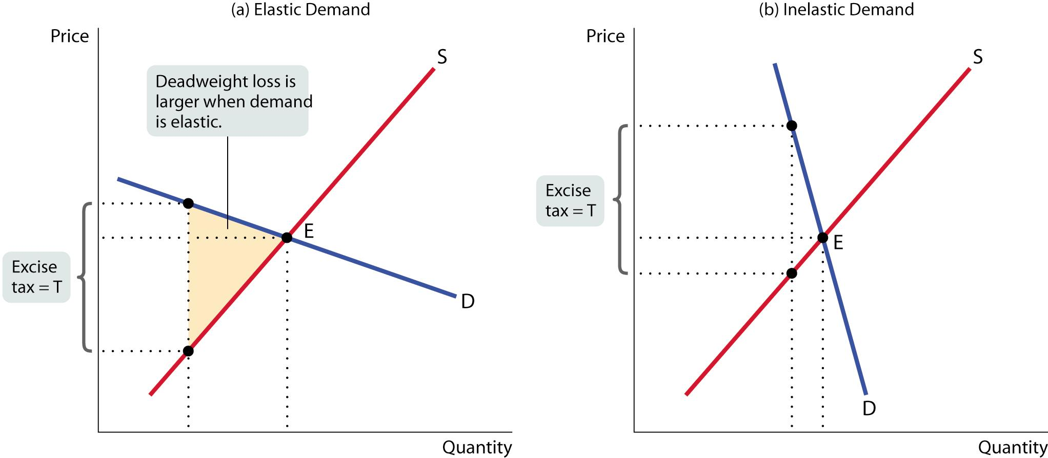
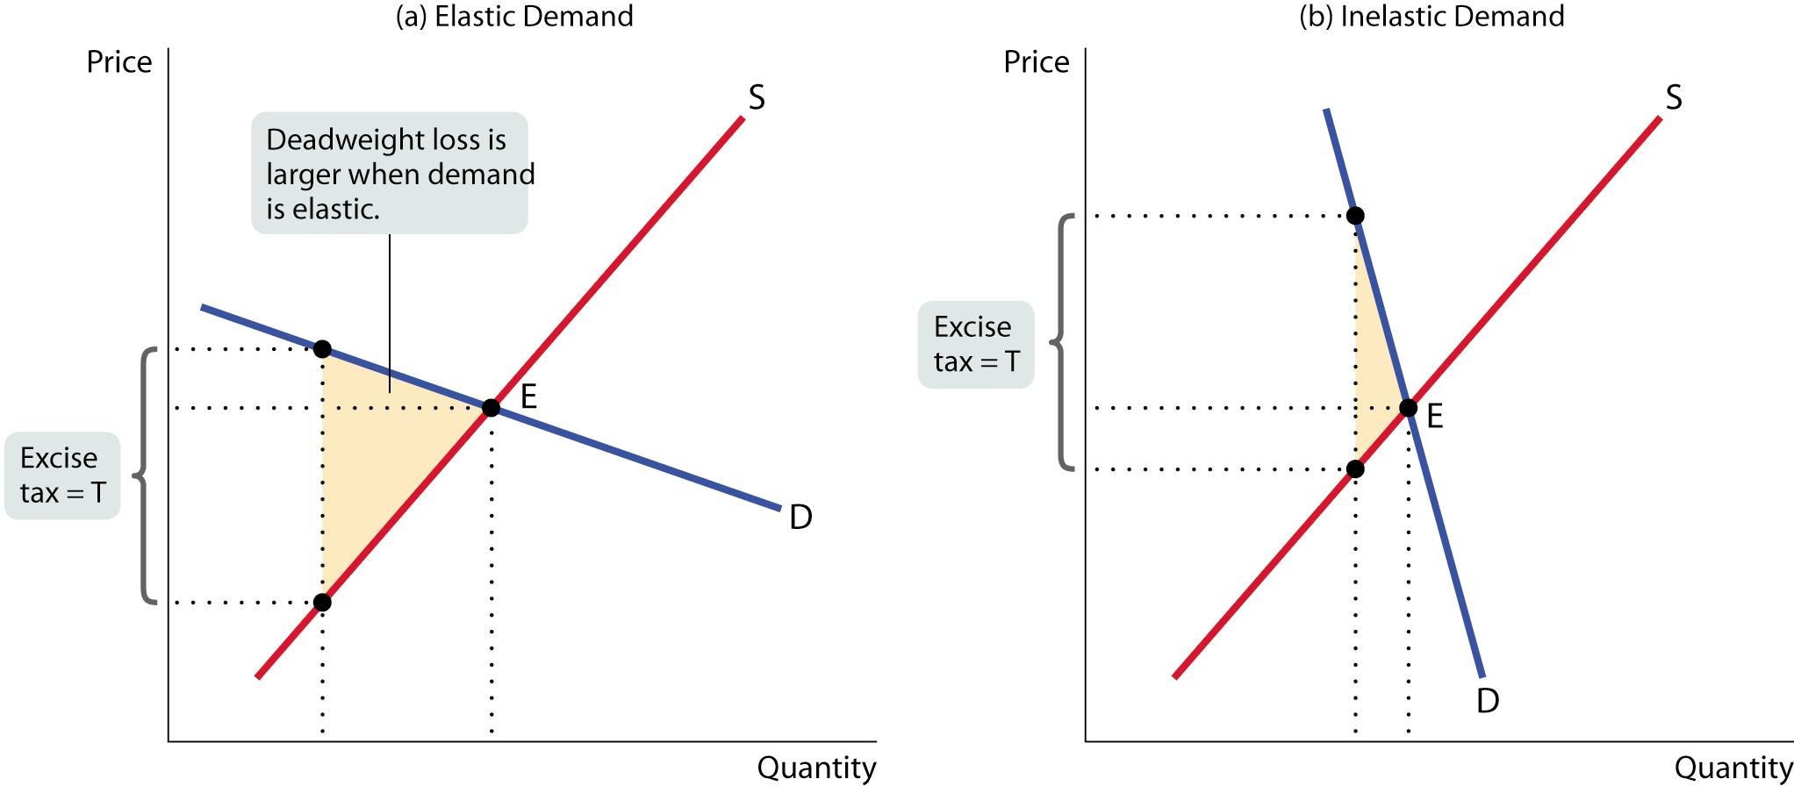
Notes:
In panel (a), the deadweight-loss is large because demand is relatively elastic.
In panel (b), the deadweight-loss is much smaller because demand is now relatively inelastic.

